Slide 1
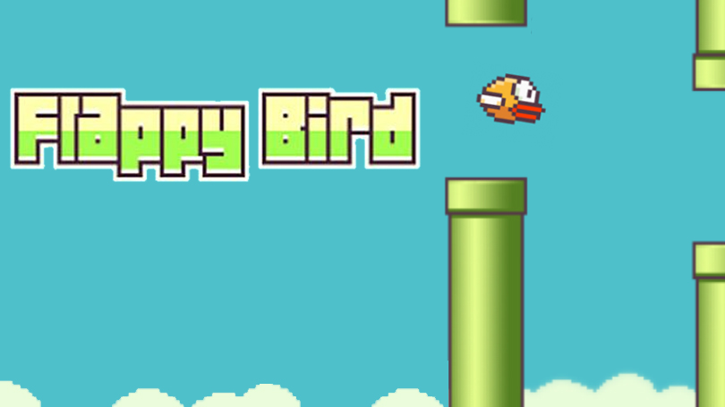
FH Graubünden | Computational & Data Science | Frédéric Kurbel | Januar 2026
Reinforcement
Learning
Tabular Q-Learning in a discretised Environment

Slide 2

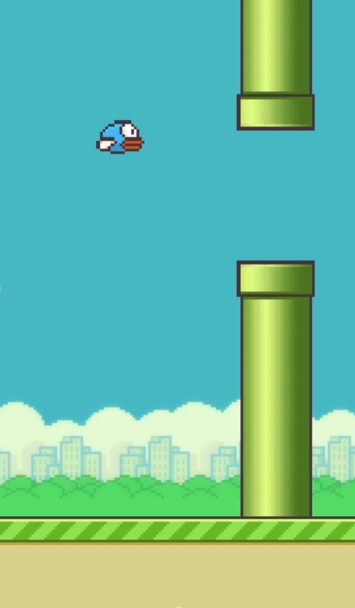

Motivation & problem setting
Flappy Bird as a sequential decision problem
Minimal action space: flap or no flap
Continuous dynamics with immediate failure on mistakes
No recovery after errors → high penalty for suboptimal actions

Slide 3
Reinforcement learning setup
Sequential decision-making problem
Agent observes a state, selects an action, and receives reward and next state
Objective: maximizie expected cumulative return
Formalized as a Markov Decision Process (MDP)
State
Action
Next State
Reward

Slide 4
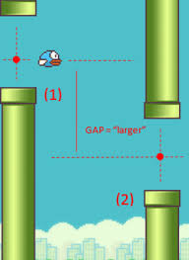
Environment model
Observed state (as implemented):
Vertical distance to next pipe gap
Horizontal distance to pipe
Vertical velocity of the bird
Continous values are discretised into finite bins.
Illustration of state variables (Source: SB Games (2019)

Slide 5
Action space & reward design
Action Space
Reward Function
Two discrete actions
Action 0: no flap (gravity-driven descent)
Action 1: flap (upward impulse)
Minimal action space reduces complexity
Forces the agent to learn when to act, not how much
+0.1 for every timestep survived
-10 on collision (pipe, ground, ceiling)
Sparse but goal-aligned reward signal
Encourages long-term survival over short-term gains

Slide 6


Q-Learning algorithm
Core Idea
Tabular Q-Learning with a explicit state-action value table
Learning mechanism
Iterative updates based on
Immediate reward
Estimated future return
Off-policy update using the maximum future Q-value
Exploration Strategy
ε-greedy policy during training phase
Gradual transition from exploration to exploitation
State | Q(no flap) | Q(flap)
s1 | -2.1 | 0.4
s2 | 1.3 | 0.9
s3 | 2.0 | -1.1

Slide 7

Training & experiments
Training setup
Episodic training (10,000 episodes)
Episode terminates on collision
Return recorded per episode
Experimental analysis
Hyperparameter ablations:
Learning rate α
ε-decay
discount factor γ
Episode start
Action selection
Reward received
Q-update
Episode end

Slide 8
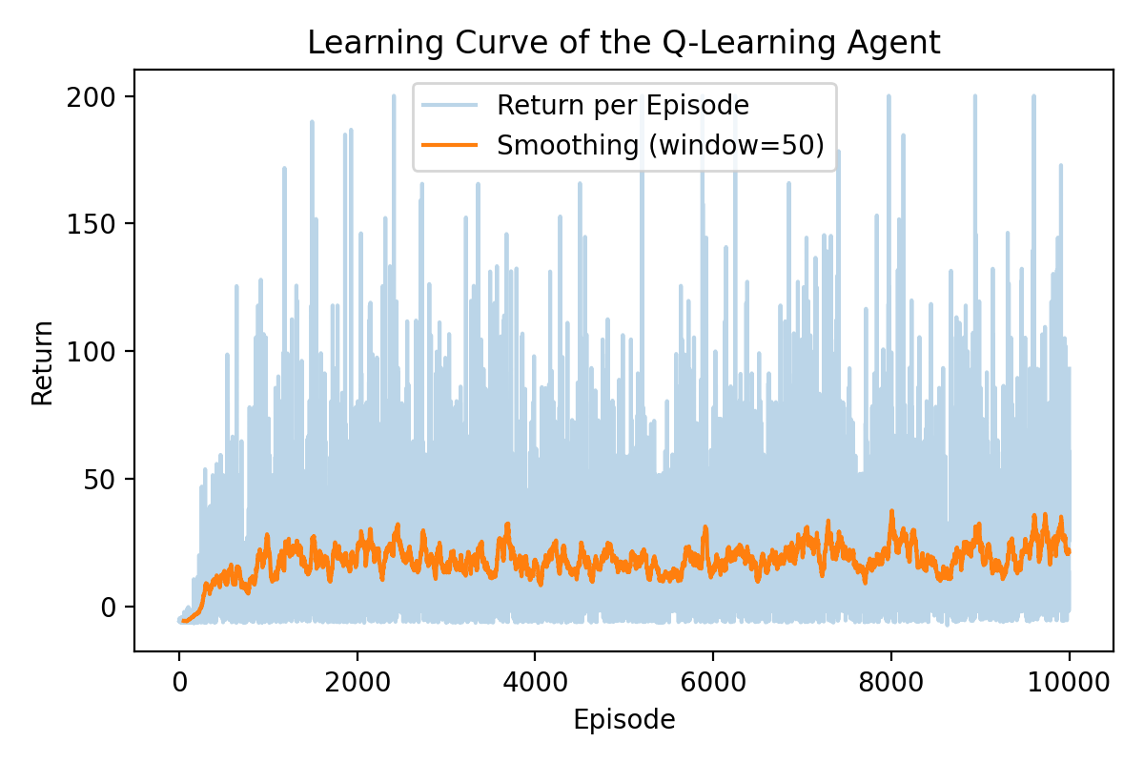
Learning curve
Strong performance improvement in early training
High variance caused by environment dynamics
Convergence after ~2,000-3,000 episodes
Stable long-term policy behaviour

Slide 9

Discussions & limitations
What works
Limitations
A simple tabular RL method is sufficient
Clear and stable learning signal
Interpretable agent behaviour
State discretisation loses information
Q-table does not scale to larger state spaces
Environment dynamics are relatively determininstic

Slide 10
Conclusion & future work
Conclusion
Tabular Q-learning can learn a stable control policy
Toy environments are effective for studying RL fundamentals
Future Work
Deep Q-Networks (DQN) for function approximation
Pixel input instead of hand-crafted state features
Refined reward shaping strategies

Slide 11
Referenzen
https://en.wikipedia.org/wiki/Q-learning
https://en.wikipedia.org/wiki/Markov_decision_process
https://www.datacamp.com/tutorial/introduction-q-learning-beginner-tutorial
https://www.baeldung.com/cs/epsilon-greedy-q-learning

Slide 12

Fragen?

